Slide 1

NET ASSET VALUE FORECASTING
How Data Science and Machine Learning can be used to make investment decisions

Slide 2





THE GROUP 2 TEAM
Deogratias Nyamhanga
UDSM, CoICT
Bsc Computer Engineering and IT
John Butoto
UDSM, CoICT
Bsc Computer Engineering and IT
Oprah Malisa
UDSM, CoICT
Bsc Computer Engineering and IT
Godfrey Enosh
ARDHI UNIVERSITY
Bsc Information Systems
Adili Said
UDSM, CoICT
Bsc Business Information Technology

Slide 3
CONTENTS
INTRODUCTION
METHODOLOGY
THE MAIN OBJECTIVE
TOOLS USED
SPECIFIC OBJECTIVES
IMPLEMENTATION
PROJECT’S SIGNIFICANCE
CONCLUSION

Slide 4

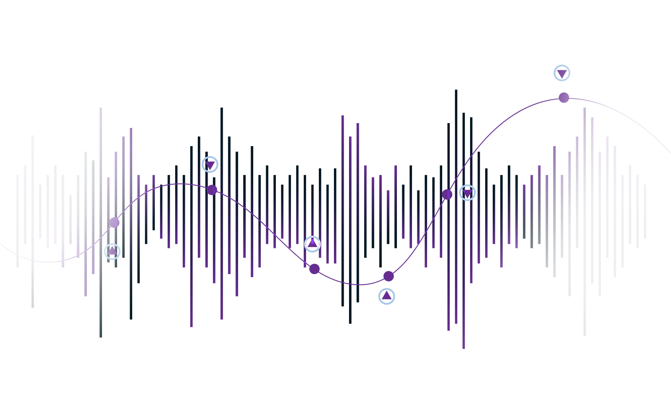
INTRODUCTION
01

Slide 5
Net Asset Value per unit: Is a measure used in finance and investment to determine the value of a single unit or share of a mutual fund, exchange-traded fund (ETF), or other investment vehicle. It is calculated by dividing the total net asset value of the fund (less its liabilities) by the total number of units/shares outstanding. NAV per unit represents the value of each individual unit/share in the fund and is often used to track the performance and value of the investment over time.
Problem Statement: Potential risk and challenge to investors who want to invest in investment funds. This risk comes in the form of incurring loses in the investments made due to lack of informed or accurate forecast of what the value of the funds/schemes will be in the future.

Slide 6
THE MAIN OBJECTIVE
02

Slide 7
The objective of this project is to develop a tool that can forecast the future trends of specific investment funds over the next six months.
This predictive model aims to assist investors and asset managers in making data-driven investment decisions and optimizing their investment allocations.

Slide 8
SPECIFIC OBJECTIVES
03

Slide 9
Collect data from UTT AMIS and perform Exploratory Data Analysis to prepare the data for the next steps and understand it in order to gain insights
Optimise model to achieve a better predictive performance
Incorporate the model into a system (web/mobile app) that can be used by potential investors
visualize the features in away that can give insights to the trends in the data that will help us have an intuition of fund’s behavior
Develop a machine learning model that can forecast the future trends of specific investment funds/schemes over the next six months

Slide 10
SIGNIFICANCE OF THE PROJECT
04

Slide 11
DECISION MAKING
LESS RISK
Accurate NAV forecasting can empower investors with valuable insights into the future performance of investment funds. This, in turn, helps them make informed investment decisions and allocate their resources effectively
By forecasting NAV prices, investors can better assess the potential risks associated with their investments. It allows for more effective risk management, helping to protect investments during market fluctuations.

Slide 12
METHODOLOGY
05

Slide 13
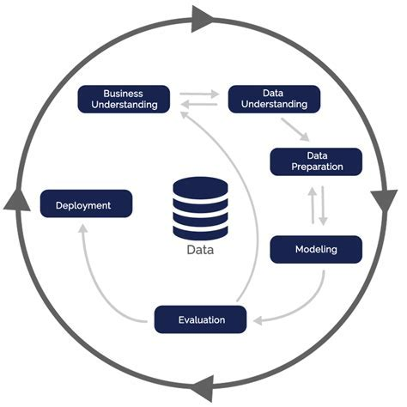
CRISP METHODOLOGY
CROSS-INDUSTRY STANDARD PROCESS

Slide 14

TOOLS USED
06

Slide 15
MAIN TOOLS USED
FEATURE ENGINEERING AND SELECTION
A Computer
Python Programming Language
Jupyter Notebooks
Python package:-
Sklearn
EXPLORATORY DATA ANALYSIS
MODELLING
Python packages:-
Prophet
Sklearn
Python Libraries and Packages:-
Numpy
Pandas
Matplotlib
Seaborn
D-Tale
MODEL DEPLOYMENT
PRESENTATION
VS code (IDE)
Git
Github
Streamlit
Microsoft Word
Microsoft Powerpoint
Gmail
Google Drive

Slide 16

IMPLEMENTATION
07

Slide 17
CROSS INDUSTRY STANDARD PROCESS (CRISP)
DATA AND BUSINESS UNDERSTANDING
Define project objectives and requirements
Understand the business application
Understand the data and its source
DATA PREPARATION
Handling missing values and duplicates
Data visualization
Feature Engineering
MODELLING
Algorithm selection
Training
Model Optimisation
EVALUATION
Model evaluation using RMSE, MAE, MSE AND R2 SCORE
DEPLOYMENT
Web-based application

Slide 18
PROJECT IMPLEMENTATION
01
02
03
04
Data and Business Understanding
Data Preparation
Modelling
Evaluation
05
Deployment

Slide 19

BUSINESS UNDERSTANDING
The goal is to predict Net Asset Value (NAV) prices for different investments to help investors and a Tanzanian firm called UTT AMIS make better decisions in a changing market. This will boost gains and improve portfolio strategies while managing risk.

Slide 20

DATA UNDERSTADNING
The data was obtained from UTT AMIS website, a public limited company for asset management and investing services
The dataset contains NAV valuesof six different funds from 2017-2022
It contains other features including Scheme Name, Outstanding No of Units, NAV Per Unit, Sale Price Per Unit, Repurchase Price Per Unit and the Data valued
The total dataset values are 9088

Slide 21

DATA PREPARATION
PREPROCESSING AND CLEANING
Clean data with no missing values and duplicates
Converted some attributes to a different data type
FEATURE ENGINEERING AND SELECTION
Converted categorical features to numerical using one hot encoder
Data scaling for continuous numeric features using minmax scaler method.
Two features were selected to train the model: the NAV per unit and the corresponding timestamps

Slide 22


MODELLING
We considered time series forecasting Facebook Prophet algorithm, to build our predictive models. Prophet, a forecasting library developed by Facebook, typically uses two features to train a model: the time series data for the variable being forecasted (NAV/unit) and the corresponding timestamps.
Performed model optimization using GridSearchCV that automates the process of hyperparameter tuning,

Slide 23

EVALUATION
For model evaluation, we used four regression evaluation metrics: RMSE, MSE, MAE, and R-squared score to assess the performace of the six models for each fund

Slide 24
TABLE SHOWING THE METRICS VALUES OF THE MODELS FOR EACH FUND
FUND NAME | R2 SCORE | MAE | MSE | RMSE
Jikimu Fund | 0.5282 | 1.4346 | 3.7046 | 1.9247
Umoja Fund | 0.8045 | 5.0629 | 47.8817 | 6.9197
Liquid Fund | 0.6920 | 2.2586 | 9.7874 | 3.1285
Watoto Fund | 0.7754 | 3.6426 | 26.4107 | 5.1391
Wekeza Fund | 0.6348 | 6.1697 | 78.2915 | 8.8482
Bond Fund | 0.6838 | 1.1268 | 1.5623 | 1.2499

Slide 25

DEPLOYMENT
Deployment involved creating a web-based application that provides a user-friendly interface for showcasing and predicting the NAV/unit prices
The application required online hosting for any user to access via a link. The application was hosted on the streamlit cloud.

Slide 26
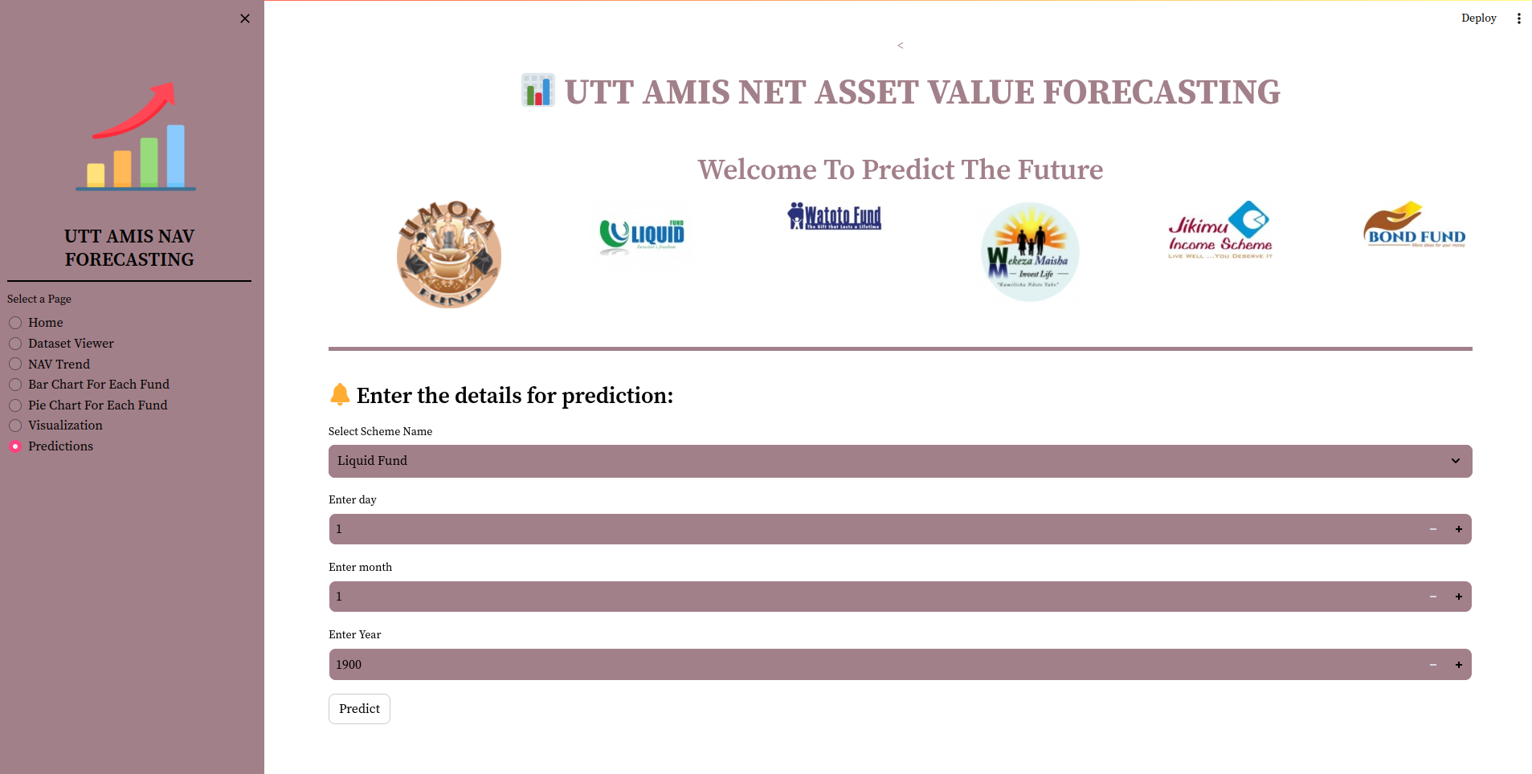
The end result was a web-based application that is capable of predicting the NAV/unit of the schemes for the next six months

Slide 27

CONCLUSION
08

Slide 28
The project gave a valuable insight into the field of data science and its practical applications, practice and sharpen skills used in real data science jobs.
Prophet model performance: It excels at automatically detecting and modeling seasonality patterns, making it suitable for data with complex periodic trends. Uncertainty. The model provides uncertainty estimates for predictions, helping users understand the range of potential outcomes. It is also suitable for beginners
Fund-Specific Trends: We observed that each fund displayed unique trends and seasonality patterns in their NAV per unit values. Some funds exhibited steady growth, while others displayed some fluctuation

Slide 29
RECOMMENDATIONS
Uncertainty and Risk Assessment: While the Prophet model provided valuable predictions, it's essential to consider potential risks and external factors that may impact fund performance, such as economic conditions and market dynamics.
Investment Recommendations: For funds showing stable growth, long-term investment strategies may be suitable. Conversely, funds with higher volatility may need a more active and risk-aware approach.
The data set had limited features, more features would have helped to analyse and understand better the trends and patterns of the funds and gain more insights for better conclusion and prediction

Slide 30
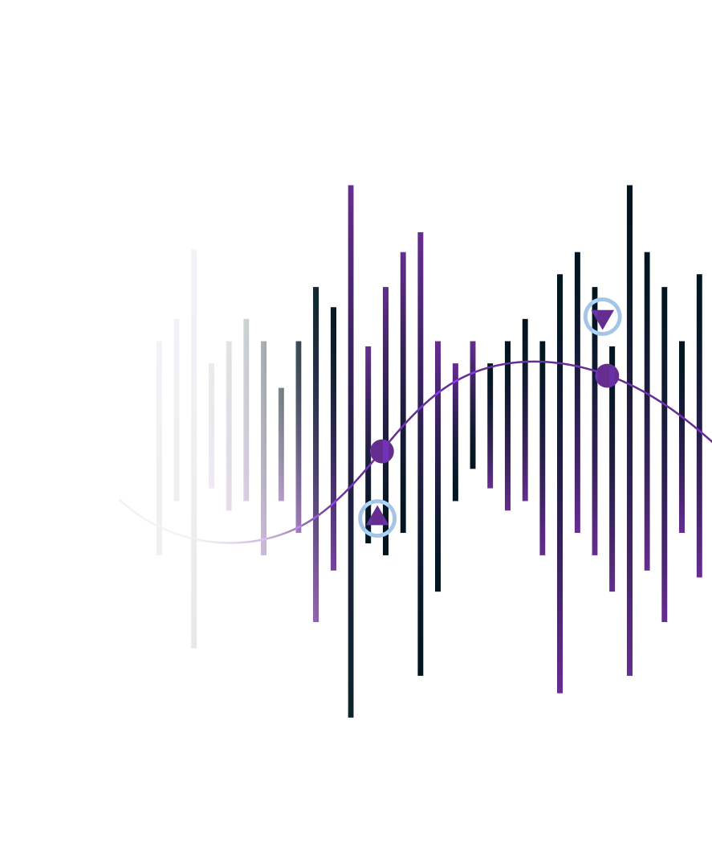
Thanks!

